Slide 1

BATCH · 17
THIRD REVIEW
CHURN PREDICTION
Confidence-Gated Explainable AI for Reliable Churn
Prediction and Automated Retention Decisions
PRESENTED BY
MENTORS
Dr. G. Sangeetha
V. P. Kanchana
Nivetha D [23619126]
Selvan Mubesh Muthamil [23619135]
Srinivasan M [23619137]
CHURN / IQ · CONFIDENCE-GATED XAI
DEPARTMENT OF ARTIFICIAL INTELLIGENCE & MACHINE LEARNING

Slide 2
01 · INTRODUCTION
01
Churn Prediction?
Churn prediction uses customer data and machine learning to forecast which customers are likely to stop using a product or cancel a subscription within a defined period — so retention teams can intervene early, not after the customer has already left.
FROM SIGNAL TO ACTION
Active Customer Signals
1
✓
Finds churn risk early and reduces it with targeted, timely action
2
Behavioural Risk Detection
✓
Builds an explainable system to identify at-risk customers and enable proactive retention
3
Explainable Prediction
✓
Integrates decision support that recommends targeted actions for reducing churn
4
Proactive Retention Action
CHURN / IQ · CONFIDENCE-GATED XAI
THIRD REVIEW · BATCH 17

Slide 3
02 · ABSTRACT
02
Abstract
1
In B2B SaaS, customer churn significantly impacts revenue and growth; traditional models provide risk scores but lack interpretability and actionable insight.
2
Proposes a confidence-gated explainable AI framework combining XGBoost and SHAP to deliver interpretable churn predictions with automated decision support.
3
Integrates multi-source data (usage, billing, support, CRM) and behavioural signals to improve prediction accuracy.
4
A confidence-based layer enables reliable actions through automation, human review, or abstention, while an AI reasoning agent explains churn causes and suggests retention strategies.
5
Enables proactive, trustworthy, and decision-driven customer retention.
KEYWORDS
XGBoost · SHAP Analysis · AI Reasoning Agent · Human-in-the-Loop · Gradient Boosting
CHURN / IQ · CONFIDENCE-GATED XAI
THIRD REVIEW · BATCH 17

Slide 4
03 · PROBLEM STATEMENT
03
Problem Statement
Project Objectives
!
The Gap Today
Existing churn prediction systems mainly focus on identifying at-risk customers but provide limited explainability, confidence assessment, and actionable retention decisions.
Develop an XGBoost-based churn prediction model for B2B SaaS customers
01
Integrate SHAP to provide clear and interpretable churn explanations
02
Implement confidence-gated decisions for automation, human review, or abstention
→
What's Needed
03
A unified framework that can reliably predict churn, explain the reasons behind each prediction, and trigger appropriate automated or human-guided retention actions.
Use an AI reasoning agent to identify churn causes and recommend retention actions
04
Enable reliable and proactive customer retention through explainable decision support
05
CHURN / IQ · CONFIDENCE-GATED XAI
THIRD REVIEW · BATCH 17

Slide 5
Literature Survey
04
04
Year | Author | Method | Key Contribution | Limitation
2026 | J. Roy et al. | FT-Transformer + XGBoost Stacking | Combines deep learning and gradient boosting and uses threshold tuning to improve precision–recall balance. | Complex hybrid architecture; limited focus on confidence-based retention decisions.
2025 | M. Imani et al. | Systematic Literature Review | Highlights ensemble and deep learning approaches and identifies class imbalance, interpretability, and concept drift as key challenges. | Does not provide an integrated predictive and automated retention-decision framework.
2025 | M. Panjapuchat & Y. Limpiyakorn | Reinforcement Learning | Enables adaptive retention decisions over time rather than static churn prediction. | Does not directly integrate SHAP explanations and confidence-gated automation.
2026 | M. J. Mufti et al. | Rolling-Window Framework | Captures evolving customer behaviour and supports dynamic, time-aware churn decision-making. | Does not explicitly integrate explainability, evidence validation, and decision control.
2025 | Y. Li & K. Yan | ML + Sampling + SHAP + Causal Inference | Identifies important churn drivers using SHAP and causal analysis and reports 97% accuracy on bank credit-card data. | Focused on banking data; limited direct applicability to B2B SaaS retention automation.
CHURN / IQ · CONFIDENCE-GATED XAI
THIRD REVIEW · BATCH 17

Slide 6
05 · RESEARCH GAP
05
Research Gap
01
Limited Confidence-Aware Decisions
02
Explainability – Action Gap
03
Lack of Explicit Decision Control
SHAP identifies contributing factors, but these are not consistently transformed into specific retention actions.
No consistent mechanism to choose between automated intervention, human review, or abstention.
Existing models focus on prediction accuracy and calibrated probabilities, but rarely use confidence to control automated retention decisions.
04
Prediction-to-Decision Gap
05
Limited Real-Time Retention
Support
06
Need for Actionable
AI Reasoning
Prediction, behavioural analysis, explainability, and retention strategy are treated as separate components, not one framework.
Risk-assessment foundations exist, but an integrated, timely, context-aware decisioning layer is missing.
Systems answer “who” and “why” but rarely “what should be done, how urgently, and by whom.”
CHURN / IQ · CONFIDENCE-GATED XAI
THIRD REVIEW · BATCH 17

Slide 7
06 · PROPOSED METHODOLOGY
06
Proposed Methodology
PIPELINE DESIGN
CORE ARCHITECTURAL HIGHLIGHTS
01
Multi-Source Ingestion
CSV / webhook logs for logins, billing & support
Abstain Intelligence
Prevents garbage-in, garbage-out predictions when data syncs fail or records stall.
02
Data Quality Gate
Quality score < 80% triggers an instant ABSTAIN
03
1d / 7d / 30d relative usage drop ratios
Rolling Velocity Engine
Feature Velocity
Prevents false alarms caused by temporary holidays or weekend lulls.
04
Predicts risk and builds 3 SHAP reason cards
XGBoost + SHAP
05
3-Tier Action Gate
ACT (>75%) · ESCALATE (55–75%) · ABSTAIN
Audit Ledger
Every decision, SHAP explanation, and quality score is logged immutably for compliance.
06
Audit & Dashboard
Append-only ledger + Gradio HITL queue
CHURN / IQ · CONFIDENCE-GATED XAI
THIRD REVIEW · BATCH 17

Slide 8
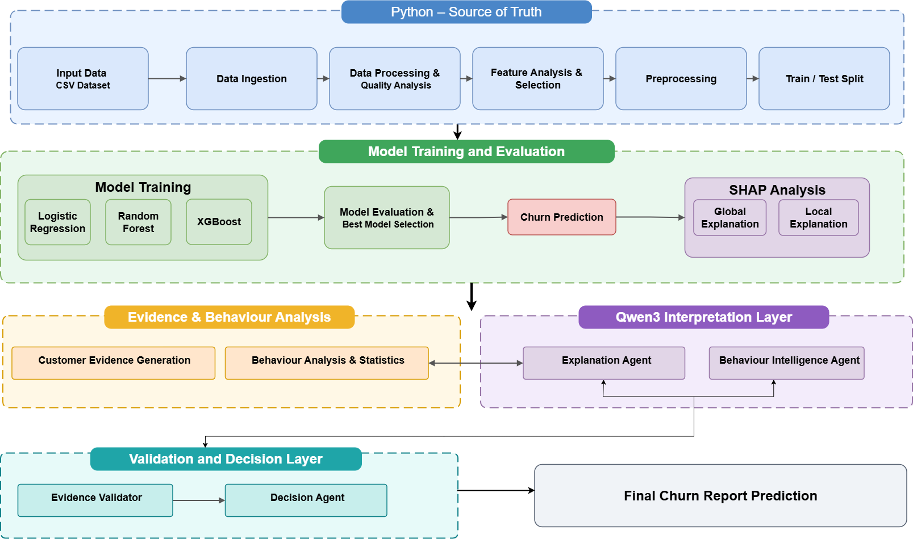
System Architecture
07
07
CHURN / IQ · CONFIDENCE-GATED XAI
SECOND REVIEW · BATCH 17

Slide 9
08 · TECHNOLOGY STACK
08
Hardware & Software Requirements
HARDWARE SPECIFICATIONS
SOFTWARE STACK
Processor (CPU)
Programming Language
Intel Core i5 / AMD Ryzen 5, 4 cores @ 2.5 GHz+ for tabular XGBoost execution
Python 3.10+
Backend API Framework
Memory (RAM)
FastAPI + Uvicorn
Minimum 8 GB DDR4 — 16 GB recommended for multi-file memory joining
Predictive Core & Explainability
XGBoost & SHAP
User Interface
Storage
Gradio Web Dashboard
256 GB NVMe SSD for fast event-log processing & PostgreSQL storage
Email Alert
Gmail SMTP
Network
AI Agent / LLM
Qwen3
Standard broadband connection for webhook ingestion & alert dispatch
CHURN / IQ · CONFIDENCE-GATED XAI
THIRD REVIEW · BATCH 17

Slide 10
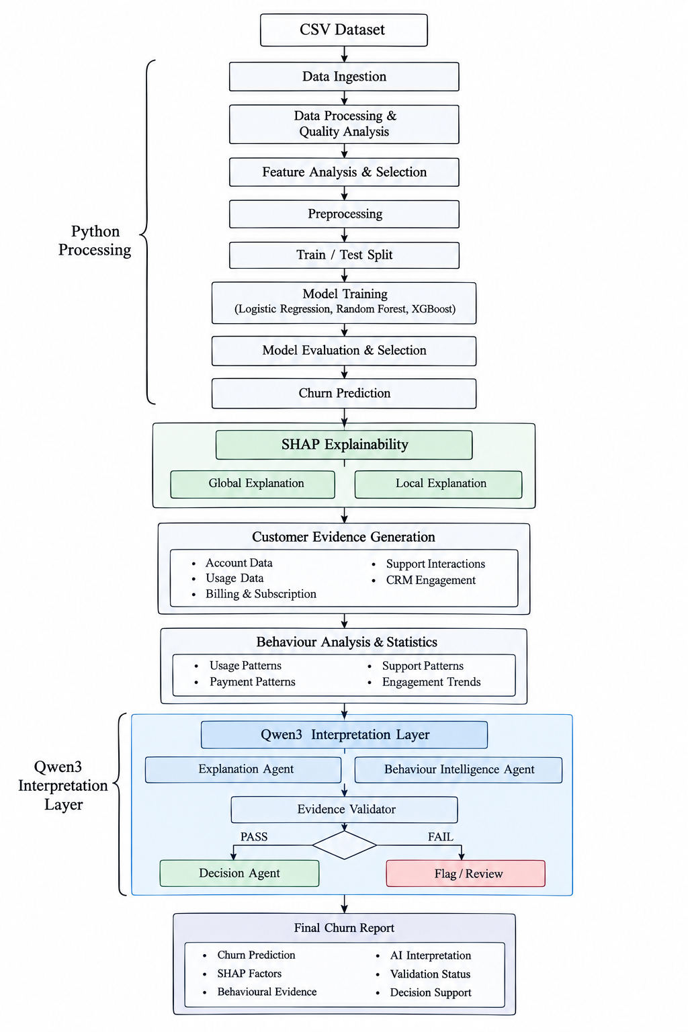
09 · SYSTEM FLOWCHART
09
System Flowchart
CHURN / IQ · CONFIDENCE-GATED XAI
THIRD REVIEW · BATCH 17

Slide 11
10 · IMPLEMENTATION PROGRESS
10
Module-Wise Implementation Progress
01
Data Integration Module
Automated dataset loading, schema detection, entity identification, and integration of multiple Telco datasets.
02
Preprocessing & Modeling Module
Data preprocessing and feature transformation integrated with the existing XGBoost churn prediction model.
03
Explainability Module
Global and local SHAP analysis to identify important churn-driving factors overall and per customer.
04
Evidence & Decision-Support Module
Customer-level prediction, churn probability, risk classification, and SHAP evidence unified into one output.
05
Validation & Evaluation Module
Behavioural analysis, Behaviour–SHAP consistency evaluation, and LLM validation with fallback mechanisms.
CHURN / IQ · CONFIDENCE-GATED XAI
THIRD REVIEW · BATCH 17

Slide 12
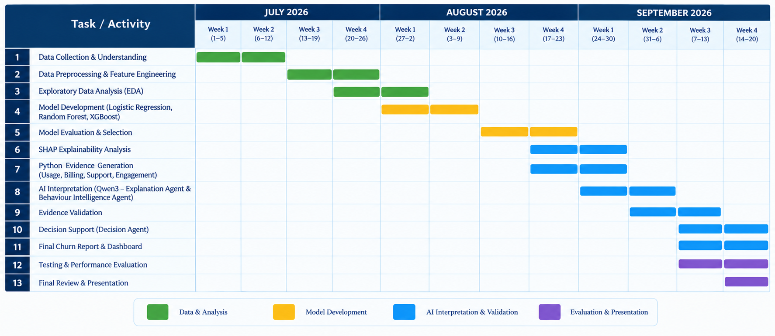
11 · PROJECT TIMELINE
11
Gantt Chart — Project Progress
CHURN / IQ · CONFIDENCE-GATED XAI
THIRD REVIEW · BATCH 17

Slide 13
12 · PROTOTYPE
12
Prototype / System Interface
DASHBOARD SNAPSHOT
Real-time, risk-ranked customer queue with churn probability and confidence band
Per-customer SHAP reason cards explaining the top drivers behind each prediction
One-click HITL actions — ACT, ESCALATE, or ABSTAIN — routed by the confidence gate
Immutable audit trail logging every decision, explanation, and data-quality score
CHURN / IQ · CONFIDENCE-GATED XAI
THIRD REVIEW · BATCH 17

Slide 14
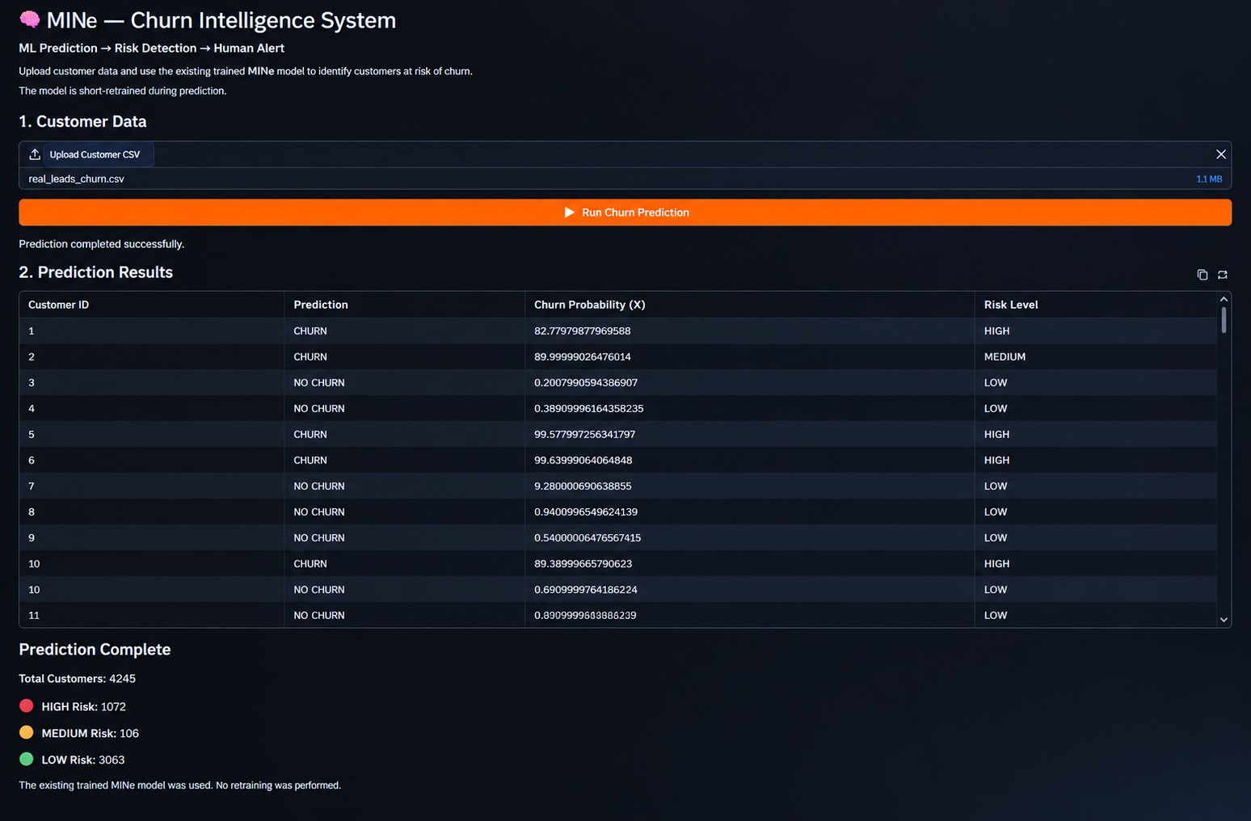
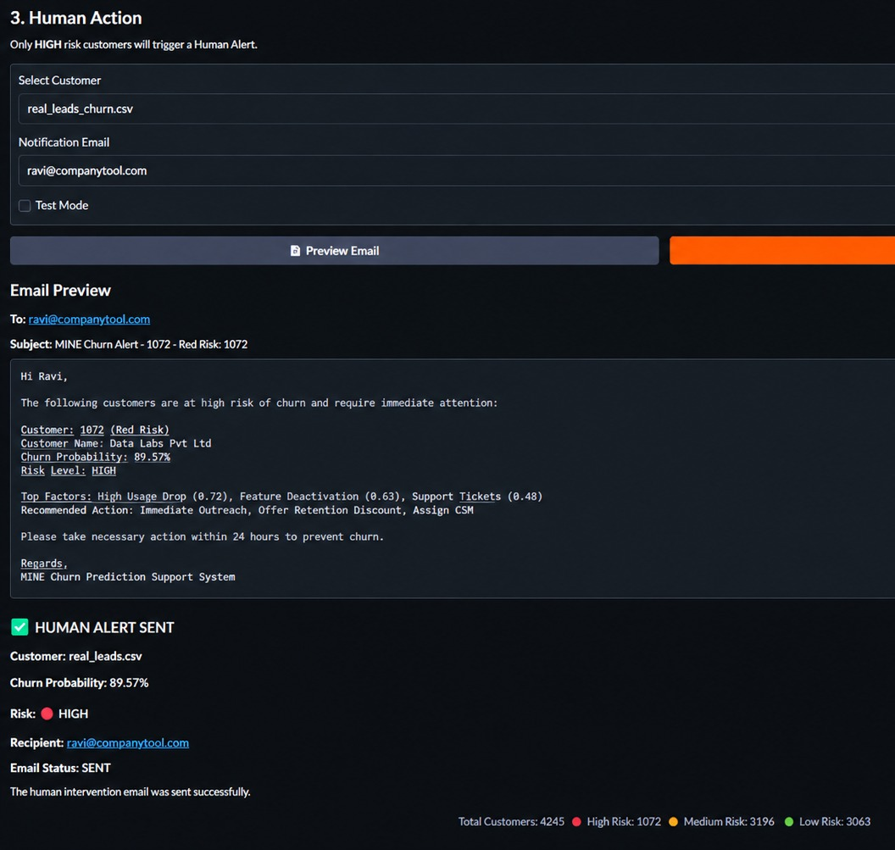
12 · PROTOTYPE
12
Prototype / System Interface
CHURN / IQ · CONFIDENCE-GATED XAI
THIRD REVIEW · BATCH 17

Slide 15
13 · RESULTS & ANALYSIS
13
RESULTS & ANALYSIS
XGBoost: 97.16% Accuracy | 94.50% F1-Score | 99.47% ROC-AUC
4,225 customers analyzed in the reference demo -- 1,072 High Risk | 190 Medium Risk | 2,963 Low Risk
SHAP identifies key factors behind individual churn predictions
Qwen3 AI Agent supports evidence-based explanation and validation
Human-in-the-loop enables reviewer validation of high-risk cases
Gmail alerts notify reviewers about high-risk customers
End-to-end workflow successfully integrated: CSV → Prediction → SHAP Explanation → Risk → AI Agent → Human Review → Email
CHURN / IQ · CONFIDENCE-GATED XAI
THIRD REVIEW · BATCH 17

Slide 16
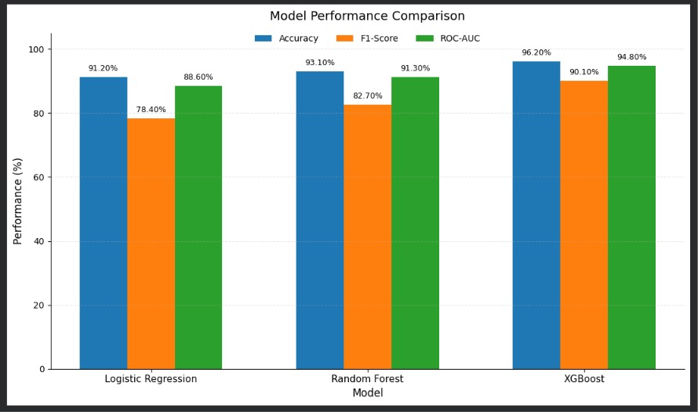
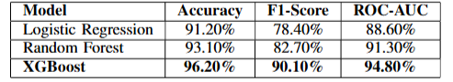
Model Comparison
13
96.20%
ACCURACY
90.10%
F1-SCORE
94.80%
AUC-ROC
Best-performing model (XGBoost) — Results & Analysis
CHURN / IQ · CONFIDENCE-GATED XAI
THIRD REVIEW · BATCH 17

Slide 17
14 · EXPLAINABILITY
14
SHAP Explainability Analysis
G
Global Explanation
L
Local / Customer-Level Explanation
Aggregates SHAP values across the full customer base to rank the churn-driving signal categories the model relies on most — usage, billing, support, and CRM engagement.
Explains one customer's individual prediction, generating 3 SHAP reason cards per at-risk account that feed directly into the confidence gate and retention action.
REPRESENTATIVE CHURN-SIGNAL CATEGORIES
Usage / Login Velocity Drop
Support Ticket Volume
Billing Delay / Payment Issues
Contract Tenure
Feature Adoption Score
CHURN / IQ · CONFIDENCE-GATED XAI
THIRD REVIEW · BATCH 17

Slide 18
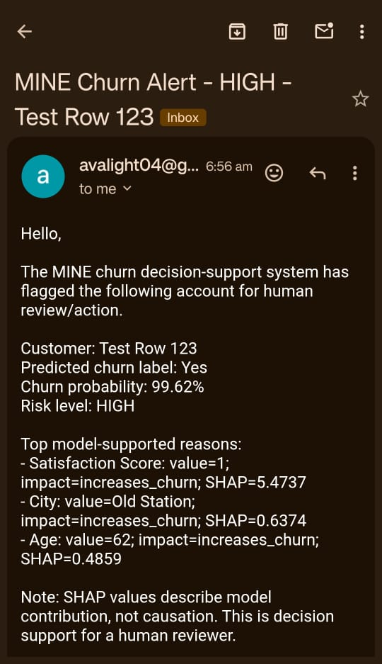
Confidence-Gated Decision Analysis
15
Prediction + SHAP Evidence + Behaviour Analysis
XGBoost risk score & reason cards
Evidence Validation
Cross-checks SHAP vs. behavioural signals
Confidence Gate
Routes on prediction confidence & data quality
ACT
ESCALATE
ABSTAIN
> 75% confidence
55 – 75% confidence
< 55% confidence, or data quality < 80%
Automated retention action triggered immediately — no human step required.
Routed to the Gradio HITL queue for human-in-the-loop review before action.
System withholds action to prevent garbage-in, garbage-out decisions.
CHURN / IQ · CONFIDENCE-GATED XAI
THIRD REVIEW · BATCH 17

Slide 19
16 · TESTING & VALIDATION
16
Testing Progress & Challenges Faced
Unit & Integration Testing
Compatibility and integration issues across modules
Resolved — automated test suite in place
24/24 PASSING
Data Input Handling
Excel dependency & ZIP extraction issues on the original dataset
Safe, dependency-free extraction and handling implemented
RESOLVED
SHAP Processing Load
Local SHAP generation produced a large ~1.23 GB artifact
Handled through chunked, per-customer processing
RESOLVED
LLM Validation
Inconsistent LLM-generated values and unsupported features
Validation checks with fallback mechanisms implemented
RESOLVED
Small-Sample Behaviour Analysis
Produced reliability warnings on limited-sample customers
Flagged with explicit confidence caveats for review
MONITORED
CHURN / IQ · CONFIDENCE-GATED XAI
THIRD REVIEW · BATCH 17

Slide 20
17 · CONCLUSION & FUTURE SCOPE
17
Conclusion & Future Scope
CONCLUSION
FUTURE SCOPE
Built a confidence-gated, explainable churn framework combining XGBoost prediction with SHAP-based reasoning.
Extend ingestion toward real-time streaming for faster risk detection.
Broaden validation across additional CRM and industry datasets.
Delivered a 3-tier decision gate — ACT / ESCALATE / ABSTAIN — that turns explanations into governed action.
Strengthen the AI reasoning agent's consistency checks and fallback coverage.
All 5 core modules are implemented, with 24/24 automated tests passing.
Expand the dashboard with deeper cohort-level retention analytics.
XGBoost achieved the strongest results (96.20% accuracy, 90.10% F1, 94.80% AUC) among the compared models.
CHURN / IQ · CONFIDENCE-GATED XAI
THIRD REVIEW · BATCH 17

Slide 21
18 · REFERENCES
18
References
[1] J. Roy, S. K. Singh, and L. Shaw, “Customer Churn Prediction on Structured Data Using FT-Transformer and Stacking Ensembles,” IEEE Access, vol. 14, pp. 62834–62855, 2026.
[2] M. Imani, M. Joudaki, A. Beikmohammadi, and H. R. Arabnia, “Customer Churn Prediction: A Systematic Review of Recent Advances, Trends, and Challenges in Machine Learning and Deep Learning,” Machine Learning and Knowledge Extraction, vol. 7, no. 3, p. 105, 2025.
[3] A. Hermawan et al., “Implementing XGBoost Model for Predicting Customer Churn in E-Commerce Platforms,” Repeater, vol. 3, no. 2, pp. 17–31, 2025.
[4] M. J. Mufti, O. Hammad, H. Saleh, and M. Gull, “A Rolling-Window Framework for Churn Prediction and Behavioral Driver Identification,” 2026.
[5] S. Kimitei, D. Agiro, S. Ni, and H. Ni, “Predictability & Explainability of Survival Analysis in Churn Prediction,” Journal of Marketing Analytics, 2025.
CHURN / IQ · CONFIDENCE-GATED XAI
SECOND REVIEW · BATCH 17

Slide 22
CHURN / IQ — Q&A
Thank You
Confidence-Gated Explainable AI for Reliable Churn Prediction and Automated Retention Decisions
Questions & Discussion
CHURN / IQ · CONFIDENCE-GATED XAI
BATCH 17 · DEPARTMENT OF COMPUTER SCIENCE & ENGINEERING (AI & ML)

